Slide 1
Flashcard the Game
Shawn Kuruvilla
https://github.com/ksu-is/flashcardgame

Slide 2
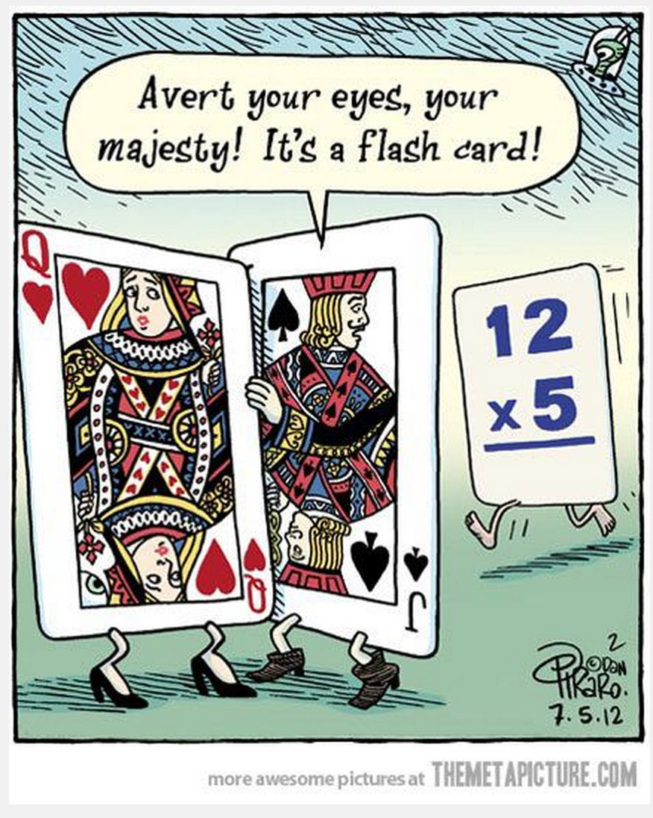
Flash Card Game
Study factor where you want to improve upon terms and keywords
Simple, Fun, and easy on the Run
Not too complicated but needs an easy experience

Slide 3
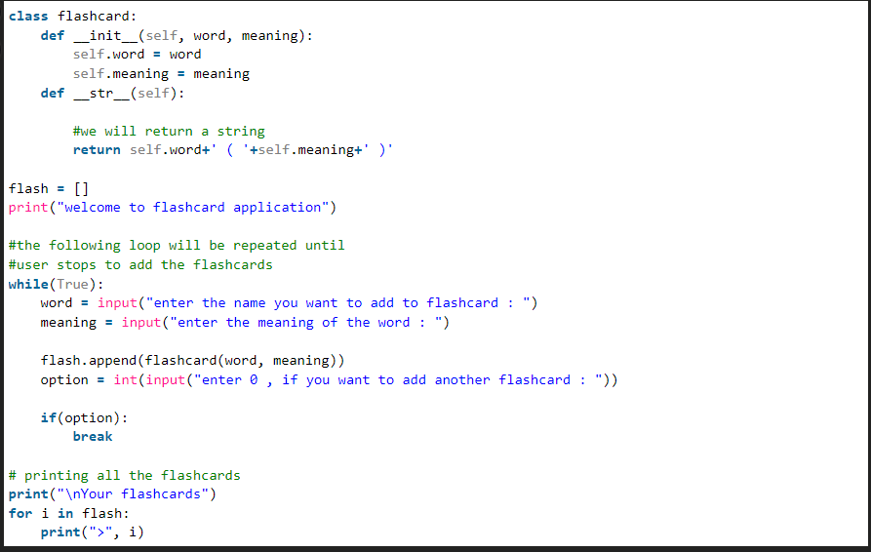
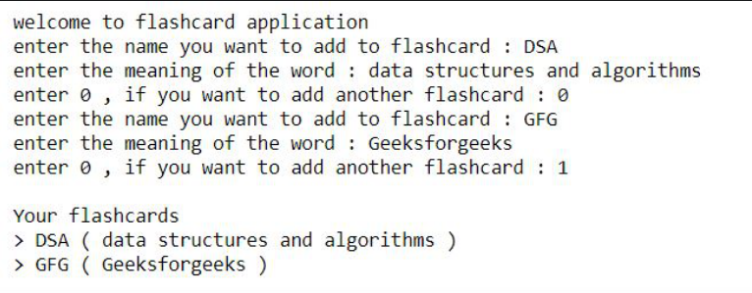
Examples
Output:

Slide 4
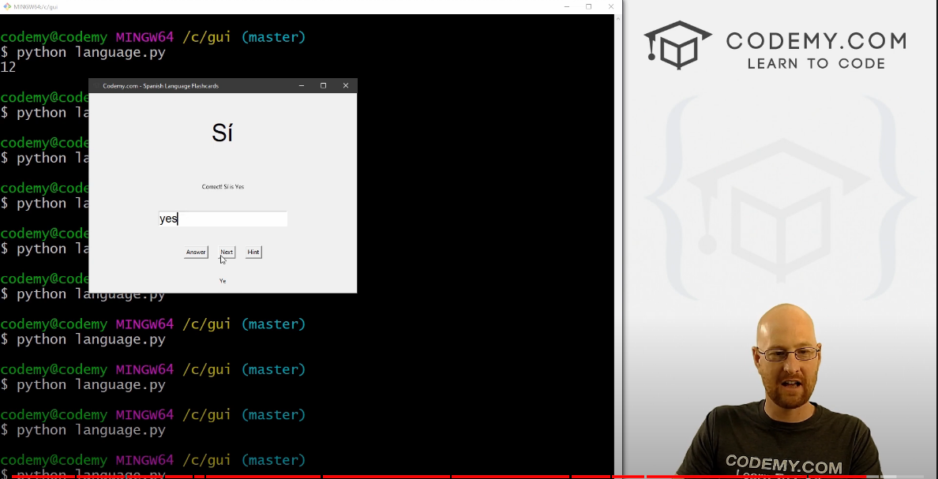
Similar Examples of a Flashcard Game for Python (Not Mine)
What I Learned:
Easy to make a flash card code
Using Tkinter GUI is a whole different learning curve but from the video he shows how simple it is for the terms and user to enter answers
The Hint Button is a good example but can be complicated with previous uses.
I want to add a point system after watching this and see if it can be an actual interactive game.
Credit: https://www.youtube.com/watch?v=Pd3XoLSQ5wg

